Slide 1
Credential Harvesting method using Social Engineering toolkit in Kali Linux
Presented by:
Maaz Sirkhot (D17c-63)
Ekta Sirwani(D17c-64)
Pallavi Varandani(D17c-69)

Slide 2

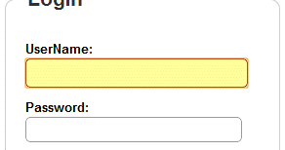

introduction

Slide 3
Problem statement
Credential Harvesting Attack is a method of grabbing credentials of the user by the means of phishing.
The cloned website is then sent to the victim through email or any other platform and manipulated as such to make the user login on the website.
Credential harvesting is commonly used by attackers to get credentials of various bank accounts, social networking accounts which can be exploited to steal money, fame, or disruption.

Slide 4
Why to do Credentials Harvesting?
The most common goal of phishing is tricking victims into providing their passwords or credentials without even being aware of it before it’s too late to save their account or confidential data.

Slide 5


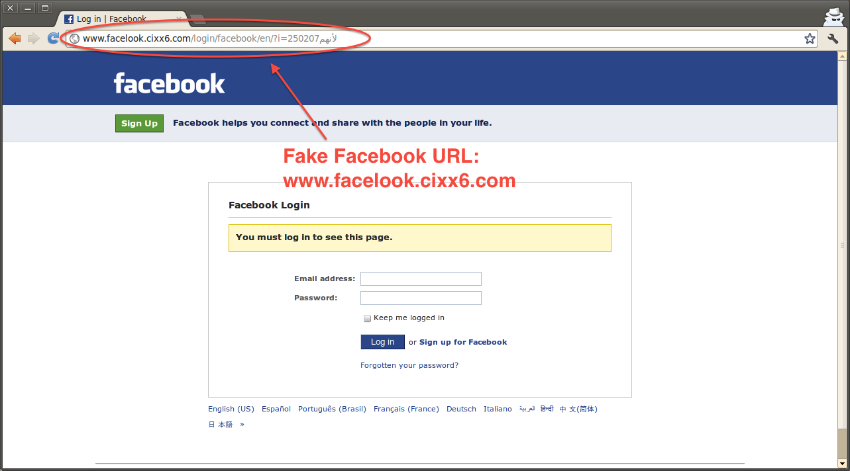

Slide 6


Conclusion

Slide 7


